Slide 1
Indian Restaurant in Toronto
Data Science Capstone Project

Slide 2
Introduction
Toronto’s high Indian population makes it a great place to open an Indian Restaurant
Challenge is to find which Neighborhood in Toronto would be ideal for that
Key considerations to choose the neighborhood –
High Indian population
Low number of restaurants currently

Slide 3
Data Sources
“List of Postal code of Canada: M” (https://en.wikipedia.org/wiki/List_of_postal_codes_of_Canada:_M)
“https://cocl.us/Geospatial_data” csv file to get all the geographical coordinates of the neighborhoods.
“Demographics of Toronto” (https://en.m.wikipedia.org/wiki/Demographics_of_Toronto#Ethnic_diversity) wiki page to fetch data regarding Indian Population at various neighborhoods.
Foursquare API (which gives venues recommendations), to get the details like Venue names, categories, Latitude, Longitude details of existing places to visit.

Slide 4
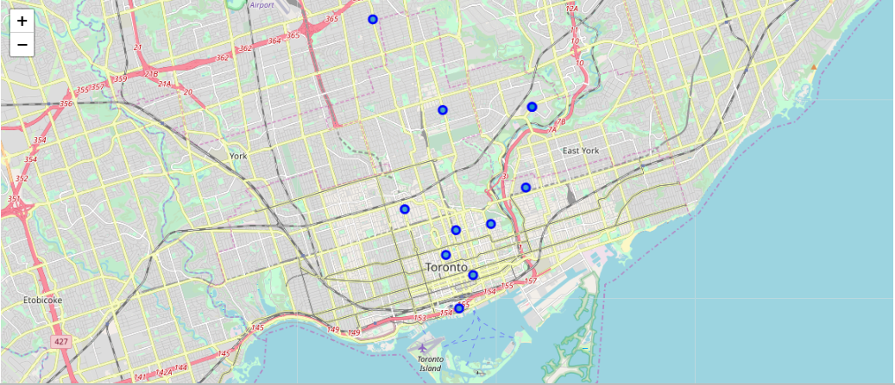
Indian Restaurants in Toronto
Huge area with no Indian Restaurant

Slide 5
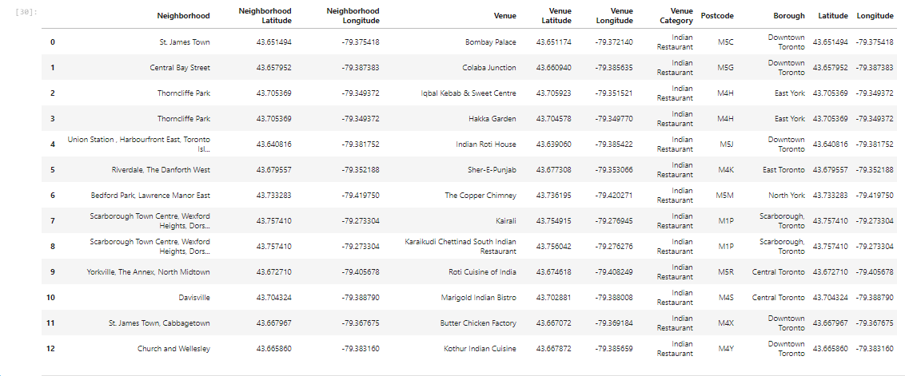
Indian Restaurants in Toronto

Slide 6
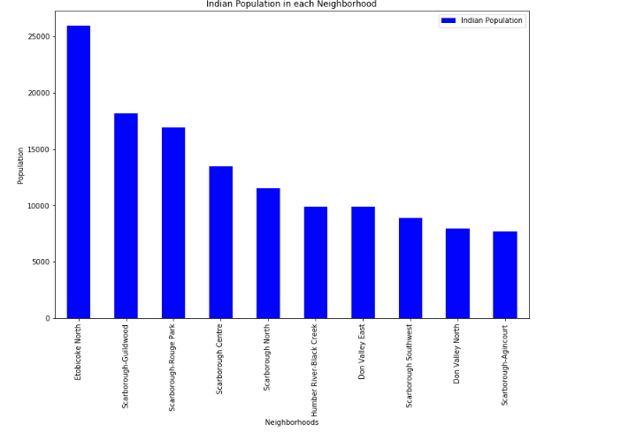
Indian Population in Toronto

Slide 7
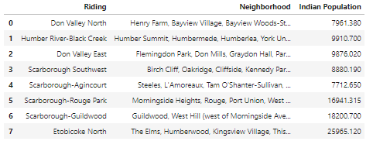
Indian Population in Toronto

Slide 8
Results
We found 13 Indian Restaurants in Toronto. Majorly located in Scarborough, East York and Downtown Toronto.
Etobicoke and Scarborough are the Neighborhoods in Toronto with maximum Indian population
Etobicoke location does not have any Indian Restaurant hence it is a good location to open a new Indian Restaurant

Slide 9
Discussion & Conclusion
Etobicoke can be considered as a prime location for an Indian restaurant.
However, the scope of this analysis is limited to the information gathered from Wikipedia and Foursquare.
Scarborough can also be considered as an option since it also has a huge Indian population and also has a few Indian restaurants which indicate that there is actually demand for Indian restaurants

Slide 10
Thank You

